Slide 1
Paper Presentation - Learning Physical Intuition of Block Towers by Example
CS 698 – Current Topics in Data Science, Spring 2018
Under the Guidance of: Dr. Roshan Usman
Presented by : Samtha Reddy
Authors of paper - Adam Lerer, Sam Gross, Rob Fergus
(Facebook AI Research)

Slide 2
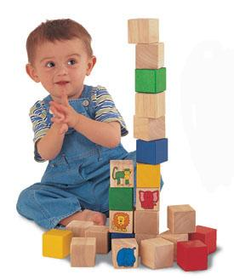
Look at the PICTURE and answer by your INTUITION
Humans don’t every time apply Newtonian concepts such as center-of-mass, stability and momentum.
Instead we rely on intuition, built up through interaction with the world.
Can we make the machines do the same? Usually method used is Simulation which implements Bayesian theory to answer this question.
This paper explores if machine can learn by images.
will the blocks fall?
:
Notes:
we can quickly assess if we can walk over a surface without falling, or how an object will behave if we push it. Making such judgements does not require us to invoke Newton’s laws of mechanics – instead we rely on intuition, built up through interaction with the world.
One of the first toys encountered by infants, wooden blocks provide a simple setting for the implicit exploration of basic Newtonian concepts such as center-of-mass, stability and
momentum.

Slide 3
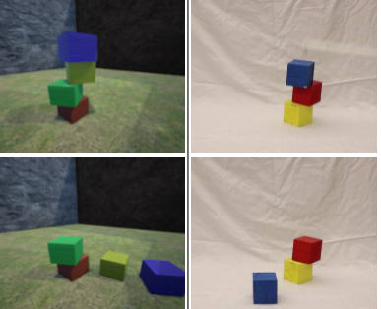
Objective:
will the blocks fall over or not? binary classiﬁcation problem based on block configuration
where will the blocks end up? predict image masks that show the location of each block. This requires the models to capture the dynamics of the system.
Block tower examples from the synthetic (left) and real (right) datasets. The top and bottom rows show the ﬁrst and last frames respectively.

Slide 4
Approach:
Models were built based on :
contemporary convolutional networks architectures (LeCun et al., 1989),
Googlenet (Ioffe & Szegedy, 2015)
DeepMask (Pinheiro et al., 2015)
ResNets (He et al., 2015).
These models are designed for classiﬁcation or segmentation, the authors adapt them to their task, using an integrated approach 5. PhysNet:-
lower layers perceive the arrangement of blocks
upper layers implicitly capture their inherent physics

Slide 5
Introducing UETorch
UETorch: An open-source combination of the Unreal game engine and the Torch deep learning environment. It is an environment for a variety of machine learning experiments in vision, physical reasoning, and embodied learning.
UETorch package can be downloaded freely at http:
//github.com/facebook/UETorch.
UETorch is an Unreal Engine 4 plugin that adds support for embedded Lua/Torch scripts in the game engine loop, and a set of Lua APIs for providing user input, taking screenshots and segmentation masks, controlling game state, running faster than real time, etc. Torch is an AI Research platform that is focused on deep learning. UETorch strongly leverages the sparsely documented ScriptPlugin plugin provided with Unreal Engine 4.

Slide 6
Dataset setup
 | Synthetic | Real | Human Subject
Method | simulation was developed in UETorch | 4 wooden cubes were fabricated & painted red, green, blue and yellow. | presented the real and synthetic dataset to 10 humans
Number of Blocks in one setup (random) | 2,3,4 | 2,3,4 | 2,3,4
film the blocks falling | 8 frames/sec | at 60 frames/sec
Count | 180,000 simulations,both blocks and stable/unstable configurations. 12,288 examples used for validation. A second held-out test set of 30,000 images was used for the reported results. | 493 examples captured, both stable/unstable configurations. The totals for 2, 3 and 4 block towers were 115, 139 and 239 examples respectively. | Training phase: 50 randomly drawn examples, participants were shown the final frame of each example, along with feedback as to whether their choice was correct or not . Testing: 100 randomly drawn examples. During the test phase, no feedback .
Notes:
Manufacturing imperfections added a certain level of randomness to the stability of the real stacked blocks, and we did not attempt to match the physical properties of the real and synthetic blocks.
Real: A white pole was held against the top block in each example, and was then rapidly lifted upwards, allowing unstable stacks to fall (the stick can be see in Fig. 1, blurred due to
its rapid motion). Note that this was performed even for stable configurations, to avoid bias.

Slide 7
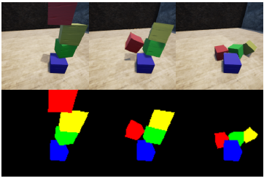
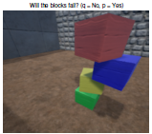
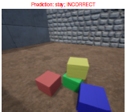
Synthetic data setup
Setup for Humans

Slide 8
Model Architectures
Fall Prediction:
Trained the ResNet-34 and Googlenet networks on the fall prediction task.
These models were pre-trained on the Imagenet dataset.
Fall+Mask Prediction
Used deep mask networks to predict the trajectory of falling blocks at multiple future times (0s,1s,2s,4s) based on an input image.
Each mask pixel is a multi-class classification. DeepMask - is an existing mask prediction network trained for instance segmentation. The binary mask head with a multi-class SoftMax,and replicated this time for mask prediction at multiple points in time (0s,1s,2s,4s).
FB team developed their own PhysNet for predicting trajectory and its results compared to DeepMask
Notes:
Replaced the final linear layer with a single logistic output and fine-tuned the entire network with SGD(stochastic gradient descent) on the blocks dataset. Grid search was performed over learning rates.

Slide 9
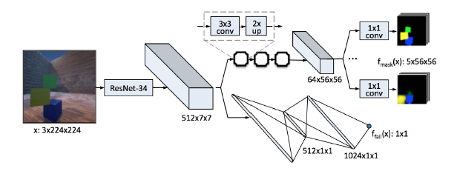
PhysNet network- developed by FB AI Team
It take the 7 X 7 outputs from ResNet-34, and performs alternating upsampling and convolution to arrive at 56 X 56 masks.

Slide 10
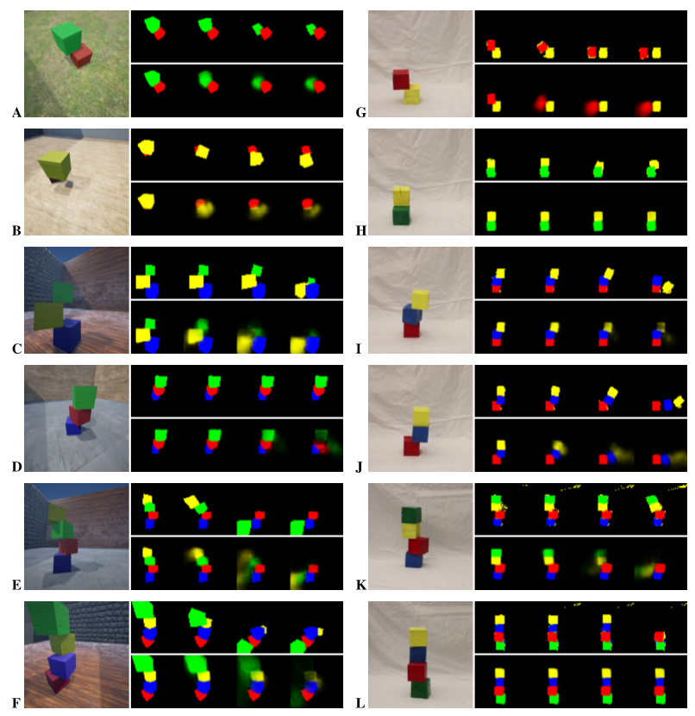
Experiment
Notes:
PhysNet mask predictions for synthetic (A–F) and real (G–L) towers of 2, 3, and 4 blocks. The image at the left of each example is the initial frame shown to the model. The top row of masks are the ground truth masks from simulation, at 0, 1, 2, and 4 seconds. The bottom row are the model predictions, with the color intensity representing the predicted probability. PhysNet correctly predictsfalldirectionandocclusionpatternsformostsyntheticexamples,whileonrealexamples,PhysNetoverestimatesstability(H,L). In difﬁcult cases,Physnet produces diffuse masks due to uncertainty(D–F,I).B is particularly notable, as PhysNet predicts the red block location from the small patch visible in the initial image

Slide 11


Evaluation
Compared fall prediction accuracy on synthetic and real images, between models and between model and human performance.
For mask predictions 2 criteria used for evaluation: mean mask IoU and log likelihood per pixel:
IOU- intersection-over-union of the mask label
Log likelihood/pixel = log likelihood of the correct ﬁnal mask under the predicted (SoftMax) distribution/ number of pixels. This is essentially the negative mask training loss.
Notes:
We deﬁne mean mask IoU as the intersection-over-union of the mask label with the binarized prediction for the t = 4s mask, averaged over each foreground class present in the mask label
where Mnc is the set of pixels of class c in mask n, Cn = {c : c ∈ {1,2,3,4}∧|mnc| > 0} is the set of foreground classes present in mask n, ˆ qnc is the set of pixels in model output n for which c is the highest-scoring class, and IoU(m1,m2) = |m1∩m2| |m1∪m2| .

Slide 12
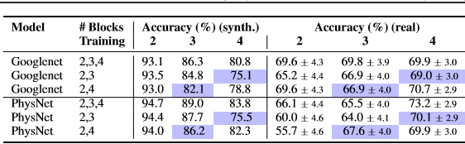

Results between Models
Notes:
The models substantially outperform baselines, and all have similar performance whether trained singly or jointly with the mask prediction task. Training Googlenet without
Imagenet pretraining does not affect performance on synthetic examples, but degrades generalization to real examples.

Slide 13
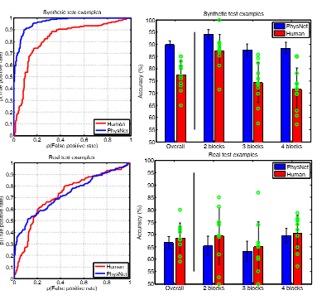
Model(PhysNet) vs. 10 Human Subjects Performance
Plots comparing PhysNet accuracy to human performance on real (Top) and synthetic (Bottom) test examples.
Left: ROC plot comparing human and model predictions.
Right: a breakdown of the performance for differing numbers of blocks.
For humans, the mean performance is shown, along with the performance of individual subjects (green circles).
Overall, the PhysNet model is better than even the best performing of the human subjects on synthetic data. On real data, PhysNet performs similarly to humans.

Slide 14
My Project
Key differenced from the Paper:
Since the dataset used for this paper is not available publically, I used similar data set from MIT paper- http://blocks.csail.mit.edu
The dataset uses both real and synthetic data and records human & machine response for each dataset. However I used only synthetic dataset and recorded system’s responses.
The paper also predicts the trajectory of the block fall, which I have not implemented.

Slide 15
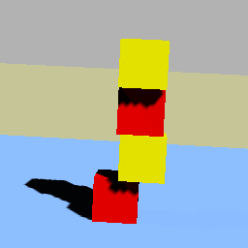
Project Implementation
Data Set Size: 3.5 GB
This dataset consists of 142,500 images of stacks of blocks
Images are divided into 1425 sets, each of which contains 100 images.
Labels are stored separately in a text file in each folder, where 1 denotes the corresponding image contains a stable stack, and 0 otherwise.
First 10 sets (1,000 images) used as test images, and the others as training images.
Size of each Image file =11kb , shape=256x256x3
Sample Image

Slide 16
Methodology:
Baseline Models:
Support Vector Machine (sk.learn LinearSVC)
Accuracy for small dataset(200 images , 2 values of C used , c=.01,1): 50.1% for both c
Accuracy for large dataset(141500 images, c=.01): 50%
Random Forest (sklearn.ensemble.RandomForestClassifier ):
100 trees and depth=6
Accuracy for small dataset(200 images): 70%
Accuracy for large dataset(141500 images): 70.9%
Note: For both SVM and RF , for large dataset we train on 141500 samples, validate on 1000 samples. For small dataset we train on 190 samples , validate on 10 images

Slide 17
Convolutional Neural Network (CNN):
Epoch =50, Batch Size=4
Resized the image =32 X 32 X 3
64 Conv filters of size 3X3 and activation = relu
32 Conv filters of size 3X3 and activation = relu
MaxPooling layer of size 2X2
Flattened the data
Dense layer of 256 neurons
Dropout of 0.5
Finally Dense layer equal to number of classes and activation = softmax

Slide 18
Accuracy of CNN:
Accuracy for small dataset(200 images, Train on 190 samples, validate on 10 samples): 60%
Accuracy for large dataset(141500 images, Train on 141500 samples, validate on 1000 samples): 81.4%
Conclusion:
CNN given in paper has a accuracy of 86% on synthetic image data and the paper states if training set is huge accuracy increases.
My CNN model has accuracy less than the what is achieved by the paper.
However we were also able to conclude the same that a CNN improves its performance by increasing the training data
Baseline models does not change performance based number of training set

Slide 19
Result Comparison
 | CNN (val_acc) | RandomForest | SVM
200 | 60% | 70% | 50.1%
141500 | 81.40% | 70.90% | 50%
Note: Further work would involve to see if I can use Alexnet pre trained weights and improve my CNN model accuracy to match the accuracy of

Slide 20
References:
1. Learning Physical Intuition of Block Towers by Example - https://arxiv.org/abs/1603.01312
2. A Comparative Evaluation of Approximate Probabilistic Simulation and Deep Neural Networks as Accounts of Human Physical Scene Understanding - https://arxiv.org/abs/1605.01138
3. “A Comparative Evaluation of Approximate Probabilistic Simulation and Deep Neural Networks as Accounts of Human Physical Scene Understanding ”Renqiao Zhang, Jiajun Wu, Chengkai Zhang, William T. Freeman, Joshua B. Tenenbaum
4. To Fall Or Not To Fall: A Visual Approach to Physical Stability Prediction by Wenbin Li, Seyedmajid Azimi, Aleš Leonardis, Mario Fritz- https://arxiv.org/abs/1604.00066
5. A COMPOSITIONAL OBJECT-BASED APPROACH TO LEARNING PHYSICAL DYNAMICS by Michael B. Chang*, Tomer Ullman** , Antonio Torralba* , and Joshua B. Tenenbaum**
6. Data set used from: http://blocks.csail.mit.edu

Slide 21
Thank You

